Slide 1

The Frank-Hertz Experiment
University Physics Experiment Center UESTC

Slide 2
content
Content
1 Background
2 Theoretical basis
3 Experiment set-up
4 Experiment principle
5 Experiment content and operation process
6 Cautions
7 Data and process

Slide 3
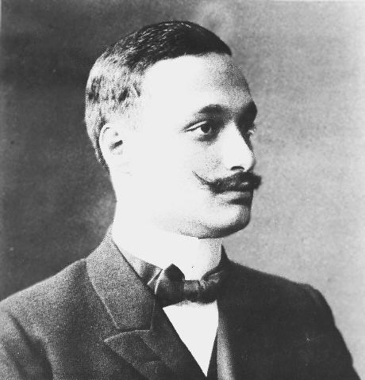
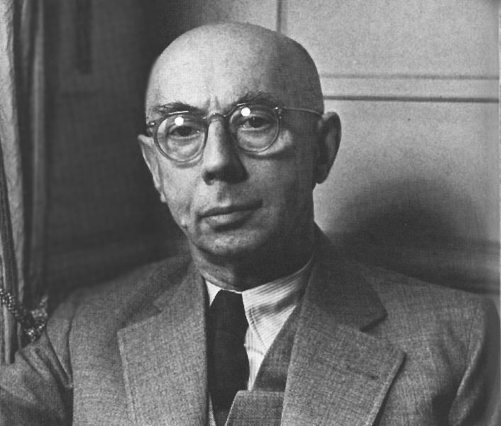
Background
1 Background
In 1911, Rutherford put forward the atomic nucleus model according to the alpha particle scattering experiment.
In 1913, Bohr applied the Planck's quantum hypothesis to the atomic nucleus model, and established two important concepts.
That were contrary to the classical theory: atomic stationary state energy level and energy level transition concept.
(JAMES FRANCK)
(GUSTAV HERTZ)

Slide 4
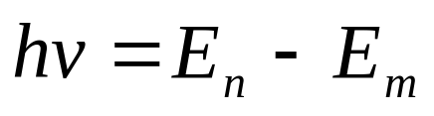
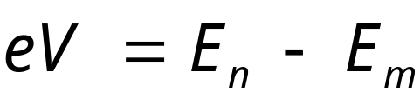
Theoretical basis
2 Theoretical basis
According to Bohr atom theory, atoms can only be in a series of discrete state of stability.
Each state corresponds to a certain energy value Ei (i = 1,2,3 ‥), and these energy values are called energy level.
The state corresponding to the lowest level is called the ground state, and the state corresponding to the other high energy levels is called the excited state.
Energy level transition
(h is planck constant)
In this experiment, we use energy of electron and atom to exchange energy, and meet the energy transition rule:

Slide 5
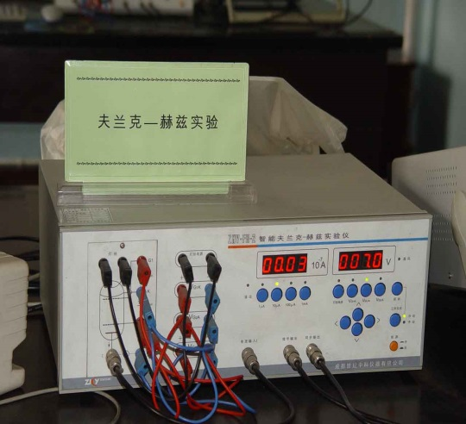
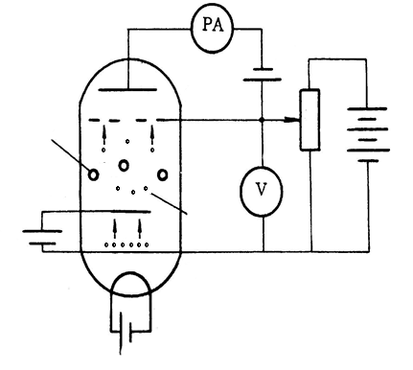
Experiment set-up
3 Experiment set-up
Features: Adopt argon Frank-Hertz tube
Argon gas for experiment measurement
4 Experiment principle
Fig F-H experiment equipment
The electrons are emitted from the cathode K.
Accelerating voltage VG1K between K and G1.
Accelerating voltage VG2K between G2 and K.
Deceleration voltage VG2A between A and G2.
A
VG2A
G2
VG2K
G1
VG1K
K
Vf
Fig. Structure diagram of F-H tube

Slide 6
Experiment Principle
4 Experiment principle
The ground state energy of the argon atom is E0, and the energy of the first excited state is E1.
The electron with the initial velocity of zero is accelerated by potential V for energy eV.
When electron energy eV<E1-E0， Electrons and argon atoms can only occur elastic collision, no electron energy lost。
If eV≥E1-E0=ΔE， Electrons and argon atoms can occur non-elastic collision ，argon atoms could get energy from electrons for ΔE，to the excited state E1，ΔE=eVC.
VC is the fist excited state of argon！
I_{A}
(nA)
e
c
a
b
d
o
o
V₁
V₂
V₃
V₄
V₅
V₆
V_{G2K}
Fig curve of F-H , Gradually increase the VG2K, ammeter current IA, as shown in the above changes in the curve.

Slide 7
Experiment content and operation process
5 Experiment content and operation process
☞ The first excitation potential of the argon atom is measured by manual and computer-on-line test, and the comparison is made.
☞ Analyze the influence of filament voltage Vk and rejection voltage VG2A on the F-H experimental curve
☞ understanding of computer data collection, data processing methods
Steps
Correct understanding of circuit connections and principles;
(VG2K = 80 V according to the parameter setting of the instrument);
☞ Start to preheat; (Note: before preheating, you must set the following values:
☞ Formal measurement; manual testing; online testing.

Slide 8
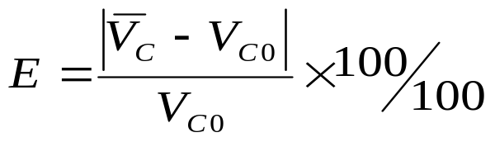
Cautions and process
6 cautions
Do not connect the incorrect circuit in order to avoid short circuit and damage.
☞ The value must be set within the given range or range. If it is out of range, it may cause the instrument to burn out or can not be displayed accurately.
7 Data process (by difference method)
The first excitation potential of the argon should be solved.
The relative error should be calculated.
Difficulties and Emphasis: the measurement process should be slow, to ensure smooth curve and a wide range of data sampling.

Slide 9
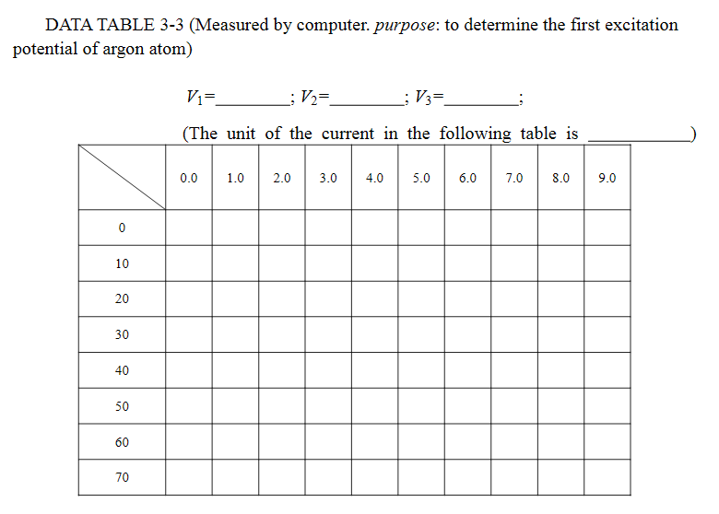
Cautions and process
Data and process

